Slide 1
Food for thought

Slide 2


Slide 3
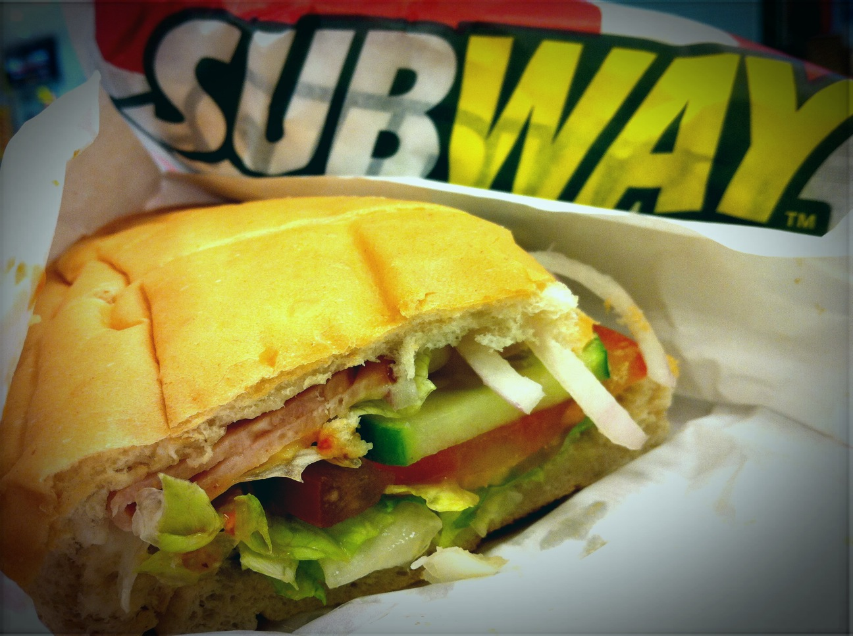

Slide 4
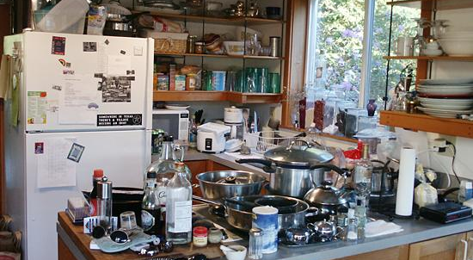

Slide 5
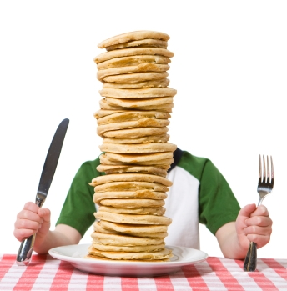
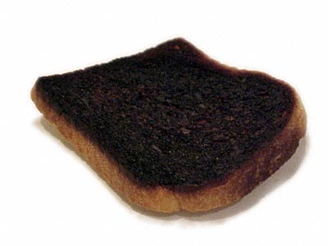

Slide 6
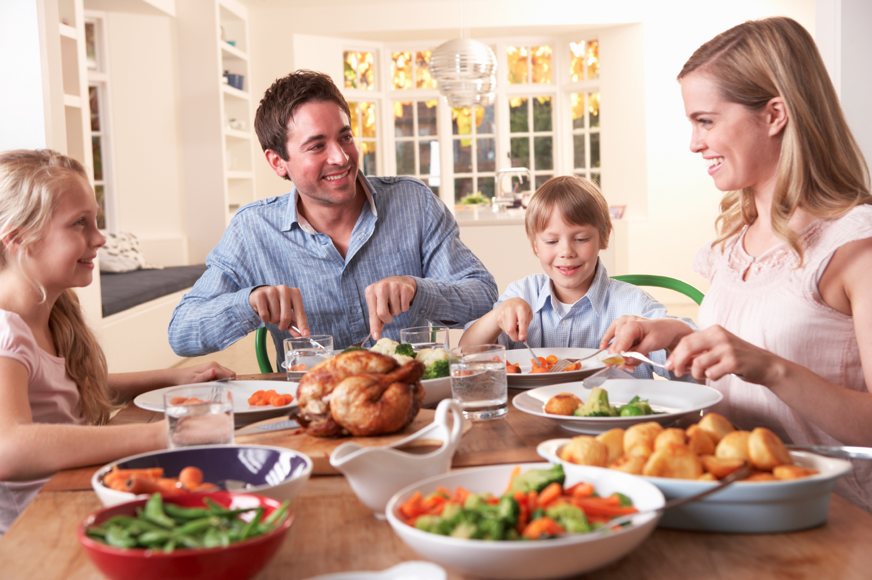

Slide 7
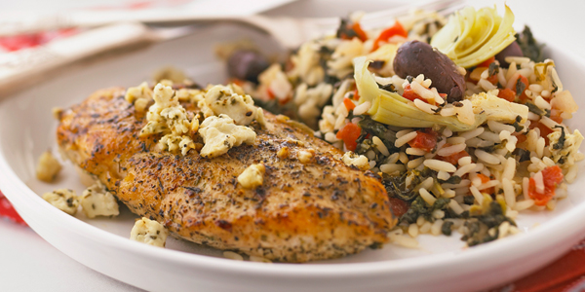

Slide 8
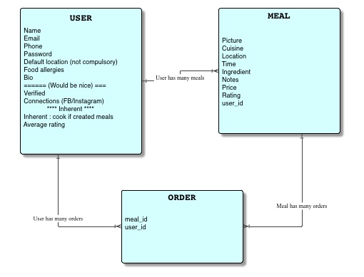
How it works
People post up meals they will be cooking
Other people buy the meals

Slide 9
Business model
Meal provider can list 5 meals for free, then pay per list or tiered subscription

Slide 10
Challenges
Quality control & trust

Slide 11
Milestones
Day | Item
Monday | CRUD & Login
Tuesday | Geolocation gem, Validation, Ratings, Notifications
Wednesday | Errors & CSS
Thursday | CSS & graphics
Friday | Extras (omniauth & active admin)

